Slide 1
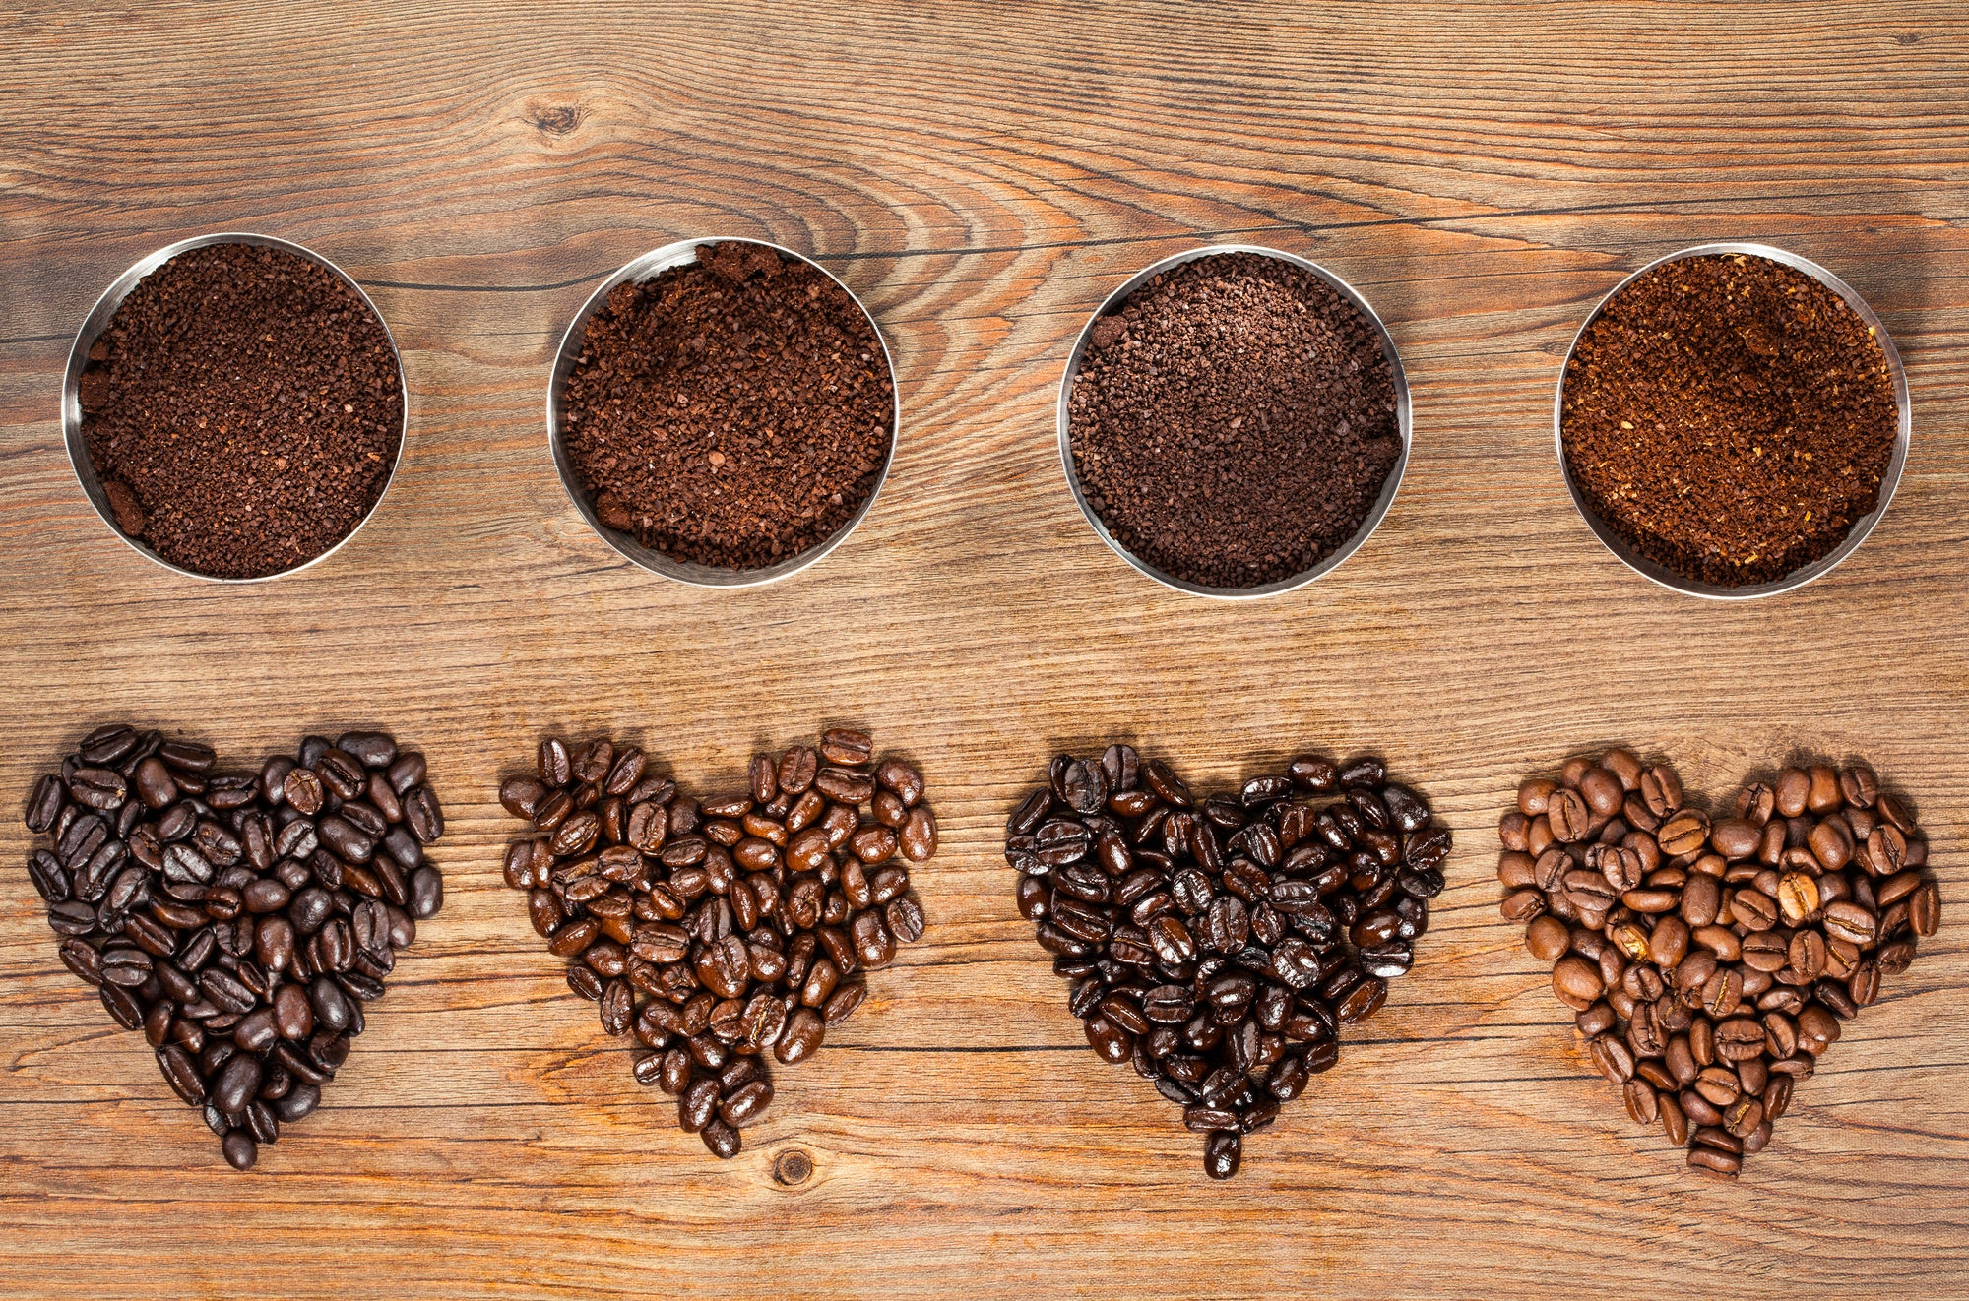
Capstone Project: Exploring Coffee Quality Data
By Govardhan

Slide 2

PROJECT OVERVIEW
The primary objective of this project is to conduct a comprehensive analysis to understand the factors that contribute to Coffee quality and improve overall Quality of Coffee .
By systematically evaluating various parameters such as flavor, aroma, Body, consistency etc., the project aims to identify key factors influencing coffee quality.
This analysis will provide insights into optimizing Variety of Coffees, Processing Methods etc., and meeting consumer expectations more effectively.

Slide 3
Business Objective and Constraints :
The Coffee Quality Institute (CQI) is a non-profit organization that works to improve the quality and value of coffee worldwide. It was founded in 1996 and has its headquarters in California, USA.
The organization works with coffee growers, processors, roasters, and other stakeholders to improve Coffee quality standards, promote sustainability, and support the development of the specialty coffee industry.

Slide 4



Technical Stacks :
POWER BI
Microsoft Excel
Microsoft Power Point

Slide 5



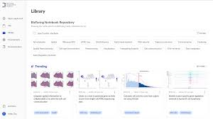




Project Architecture :
Business Understanding
Data Understanding
Data Collection
EDA
Publish
Data Visualization
Data Modelling
Data Preprocessing

Slide 6
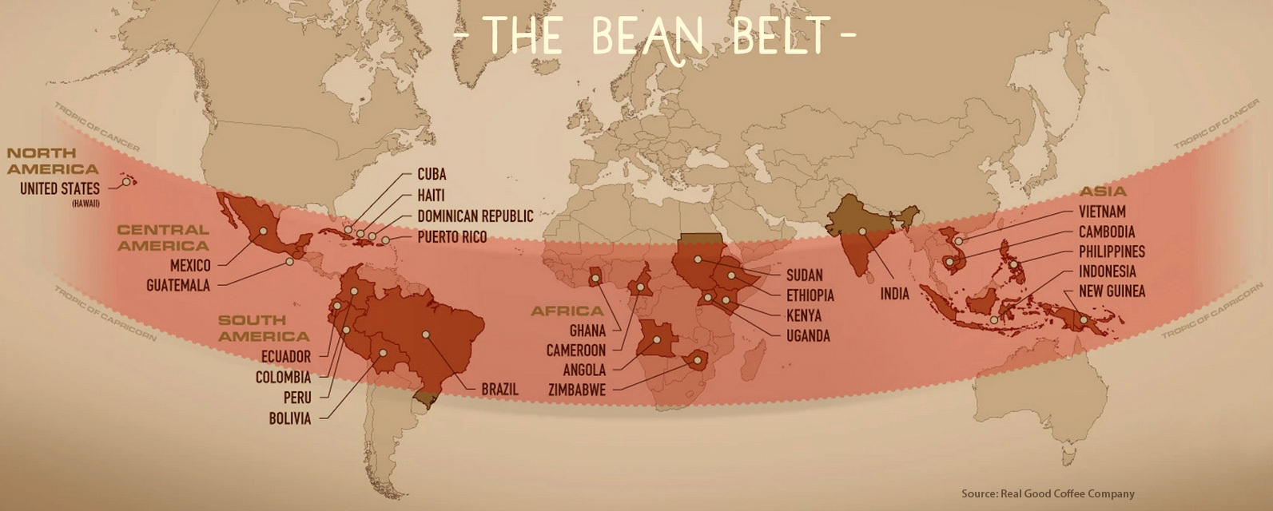
Map Showing Coffee Producing Regions across Globe

Slide 7
Table of Contents
01
EDA
04
Visulaization
02
Data Preprocessing & Feature Scaling
05
03
Data Modelling
Analysis Report
06
Insights

Slide 8


Slide 9

Coffee is grown across the globe in what is sometimes called the bean belt, but could simply be described as near the equator. This is why the coffee capitals of the world include Brazil, Columbia, Ethiopia, Indonesia, and Vietnam. Spread over three continents they all share similar equatorial climates perfect for coffee production.

Slide 10
Data: The data includes a range of information on coffee production, processing, and sensory evaluation. It also contains data on coffee genetics, soil types, and other factors that can affect coffee quality.

Slide 11

AROMA: Refers to the scent or fragrance of the coffee. COFFEE AROMA AND ITS RELATION TO COFFEE TASTE AND ACIDITY A coffee's aroma is also related to the coffee's flavor and acidity. For example, if a coffee is very rich-flavored, then the aroma will also reflect that richness, and if a coffee is acidic it will smell acidy. o Some of the more subtle flavor notes (e.g., high, fleeting notes) of a coffee appear most clearly in the aroma. Since human senses tend to work in concert, the aroma may also affect the coffee flavor characteristics/taste sensations, which may be very subtle. COFFEE'S VOLATILE COMPONENTS AND THEIR EFFECT ON AROMA o A coffee's aroma, which may range from herbal to fruity, is created by the coffee's volatile components - vapors and gases - which are released from the brewed coffee and then inhaled through the nose where they come in contact with the olfactory (nasal) membranes.

Slide 12
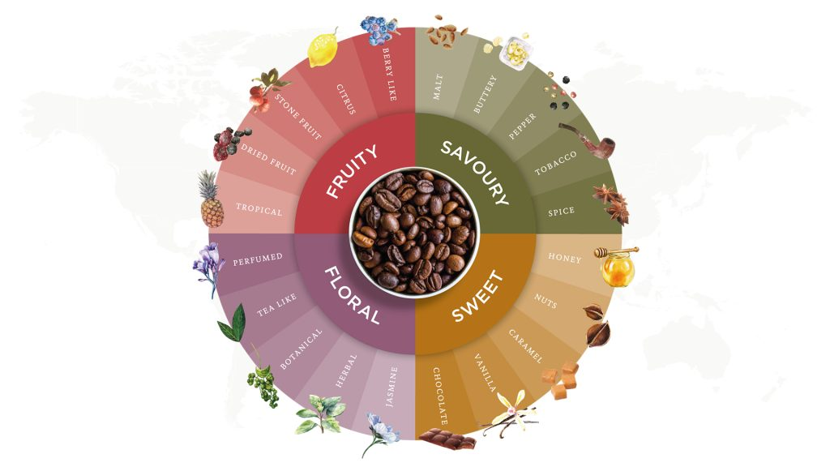
FLAVOUR: The flavor of coffee is evaluated based on the taste, including any sweetness, bitterness, acidity, and other flavor notes. o The water-soluble taste and aromatic compounds of coffee are perceived primarily through smell (the olfactory membranes) and taste buds (nerve endings on the tongue). o A well-balanced coffee is one in which no single flavor characteristic dominates and/or overpowers/overwhelms the others. o Some general coffee flavor descriptions include complex (multi-flavored) and rich (describes a full-bodied coffee). Some coffees have a flavor reminiscent of red wine and are referred to as winey. Other coffees have a fruity essence that suggests berries or citrus.

Slide 13
Acidity: Acidity in coffee refers to the brightness or liveliness of the taste. o Acidity is one of the major coffee characteristics along with body, aroma, sweetness, bitterness, and aftertaste used by coffee professionals to describe the taste of a coffee. Acidity is a pleasant snap or crispness and is a desirable characteristic. o Dark roasted coffee beans retain less acid than lighter roasts. o coffees grown at higher altitudes tend to have a higher acidity, due to the slower growth at those elevations, which allows the beans to develop more of their chemical compounds (chlorogenic acids) that contribute to flavor. Body: The body of coffee refers to the thickness or viscosity(చిక్కదనం) of the coffee in the mouth. o At its simplest, a coffee’s “body” is its texture. A coffee with a full body has a weight, or a fullness, that your mouth perceives when you drink it. o During the roasting process, experts can control the temperature to stretch out the “first crack” process and increase the amount of insolubles in the coffee, leading to a denser, more syrupy body.

Slide 14
Balance: Balance refers to how well the different flavor components of the coffee work together. o A well-balanced coffee is in that no single attribute overpowers the others. One may stand out slightly, but you are still able to single out the distinct aroma, taste and acidity. And this is where slowing down with every sip becomes all the more important. Uniformity: Uniformity refers to the consistency of the coffee from cup to cup. o The Uniformity attribute is defined as “uniformity between cups in the same coffee sample,” or in other words, the uniformity of the coffee beans in the batch. Clean Cup: A clean cup refers to a coffee that is free of any off-flavors or defects, such as sourness, mustiness, or staleness. o A coffee has a “clean cup” if no unusual or “non-coffee like” tastes or aromas (which could be a result of defects) interfere with a coffee’s taste or aftertaste. Sweetness: It can be described as caramel-like, fruity, or floral, and is a desirable quality in coffee.

Slide 15
Country of Origin - Each origin has different heights in which coffee grows best. Kenya, for instance, grows coffee in areas much higher than Brazil. Specifically at origin, a higher altitude means slower ripening; slower ripening means a higher density in the seed. The higher density can mean more sweetness, a better quality acidity and more complexity. Altitude - Coffee growing altitude is key when it comes to your cup. It’s a major player in determining the beans’ quality, shape, size, and flavor. Higher altitudes have cooler temperatures than lower altitudes. These cooler temps slow down coffee growth, allowing plants to spend more time reproducing and developing beans. More complex sugars are produced when the beans have more time to develop, leading to more potent tasting notes and decadent flavors. Coffees grown at lower elevations (i.e., Robusta coffees) tend to have blander flavors and less depth. Variety - The type of coffee bean used can have a significant impact on the taste and aroma of the final brew.

Slide 16
 | Total Cup Points | Acidity | Aroma | Coffee Production | Category One defects | Category Two defects | Flavor | Cup Points | Body
Country | Strongly Related –Ethopia has Highest Cup points. El Selvadoe has least. | Strongly Related | Strongly Related | Ethopia is the highest Production in coffee | Mexico has highest defects | Ethopia & handurus are highest | Madagascar has good flavor. ElSalvadoe has less flavored. | Ethopia has highest Cup Points
Color | Color slightly impacts Cup Points | Impacts. Brownish-green has high acidic nature. | No Impact | Greenish coffee beans are much produced. | Greenish are much damaged |  | Brownish-green good flavoured | Brownish-green has high cup points
Altitude | 1000-2000 feet | 1000-2000 feet | 1000-2000 feet |  |  |  | 1000-2000 feet | 1000-2000 feet
Variety | Castillo has good cup points, Maragogype has less | Castillo has high acidic nature | Castillo has good Aroma | Eitheiopian Heirlooms is the high productive coffee | SHG has high defects | Sharchimor has high defects | Castillo has good Flavor | Castillo has good cup points, | Castillo has good body
Moisture |  | b/n moisture 8-10, good acidity | b/n moisture 9-12.3, good Aroma |  | Defects b/n 10-12 Moisture | High b/n Moisture 10-12 | b/n moisture 9-10.9, good flavour | b/n moisture 9-12, good Cup points
Processing Method |  | Double Anaerobic Washed has high acidity | Double Anaerobic Washed has good aroma |  | Washed/wet has high damage | Washed/wet has high damage | Double Anaerobic Washed has good flavour | Double Anaerobic Washed is good | Double Anaerobic, Honey, Mostto, Semi washed has good Body

Slide 17
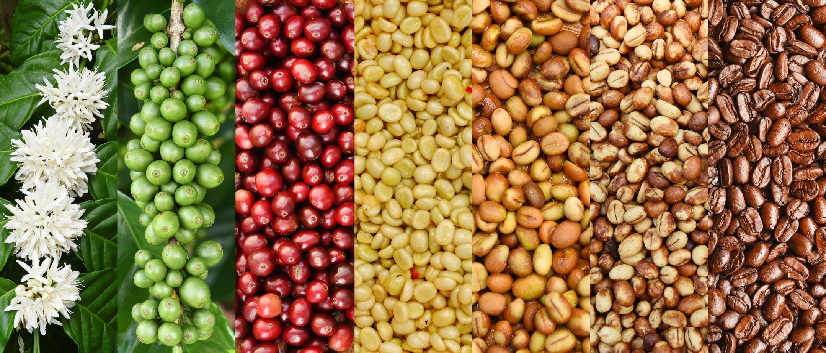




Slide 18
Data PreProcessing in Power Query Editor:
1. Country Of Origin – Renamed to Country
2. Lot Number – replaced null with fill down. Converted Chinese to english
3. Altitude – Splitted twice & created 3 columns. One delimiter column deleted. Converted datatype to number.
-Only one blank in Altitude.1, replaced blank to null, 1 blank filled with fill down.
-Datatype to whole number for both columns
-Created a new column with condition calculating average of range, if there is a range in altitude.
4. Region – Removed Empty, So 207 rows to 205. 2 Rows deleted. Replace Chinese language words to English for Consistency
5. Number of Bags – Clear
6. Bag Weight – Extracted kg from Weight & converted to Whole Number

Slide 19
Data PreProcessing in Power Query Editor:
7. In-Country Partner – Replaced Chinese words to English
8. Grading Date – Replaced st, th, st, nd with space, Augu to August & change type to Date.
9. Variety – Replace blank to null, Fill Down the null
- Also there were unknow & unknown rows, but from Country Taiwan only.
10. Processing Method - Replace blank to null, Fill Down the null
11. Color – Replaced the text corrections
12. Expiration : Replaced corrections & change type to Date.
13. Remaining all the columns are clear with no errors.

Slide 20
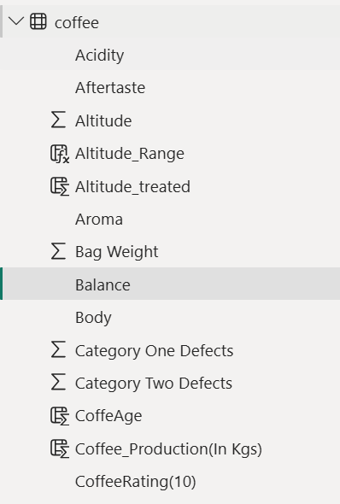
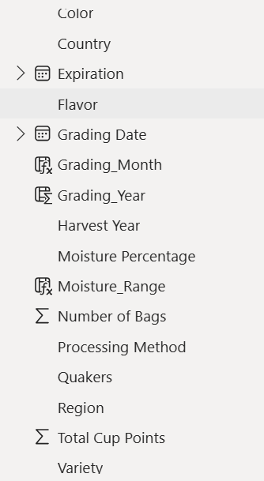
Feature Scaling :
New Column Added
Altitude Range
Coffee_Production
Grading Month
Grading Year
Moisture Range
CupPoints - New Table Added
New Measures added :
Acidity_Avg
Afterytaste_Avg
Aroma_Avg
Avg_Cuppoints
Balance_Avg
Body_avg
Flavour_Avg

Slide 21


Data Modelling!

Slide 22
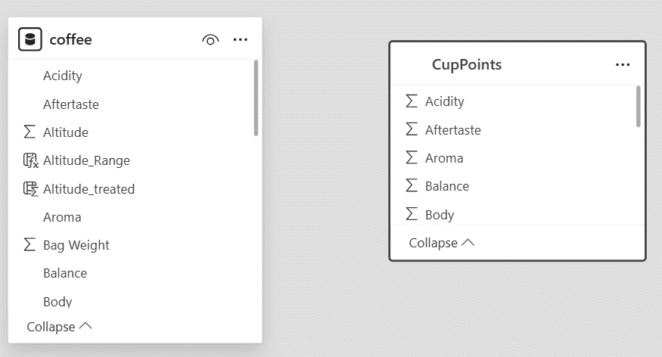

Slide 23
01
Visualization
Feature Analysis with Visulaization

Slide 24

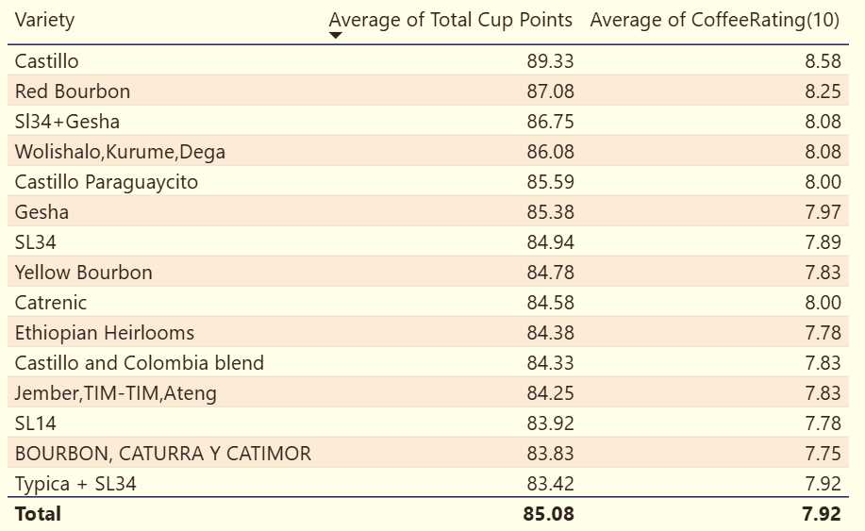
Coffee Quality vs Variety Of Beans

Slide 25
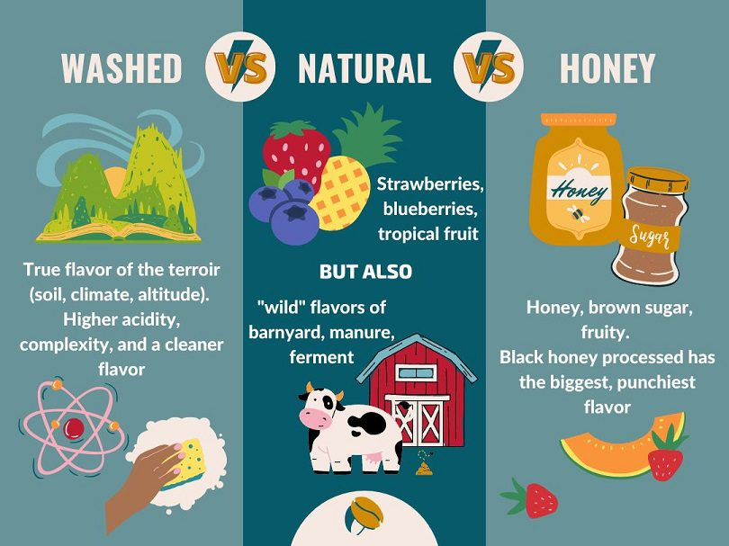
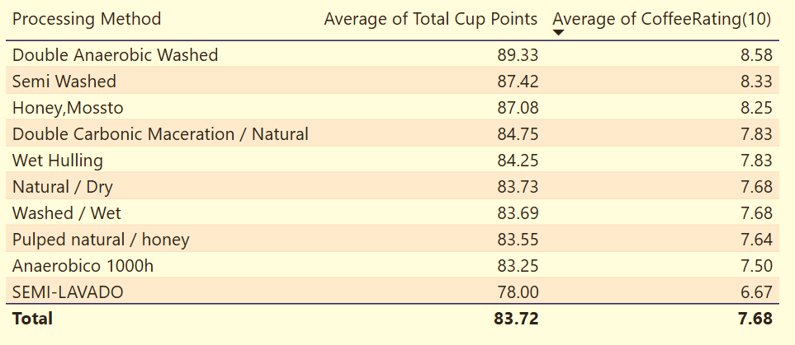
Coffee Quality vs Processing Method

Slide 26
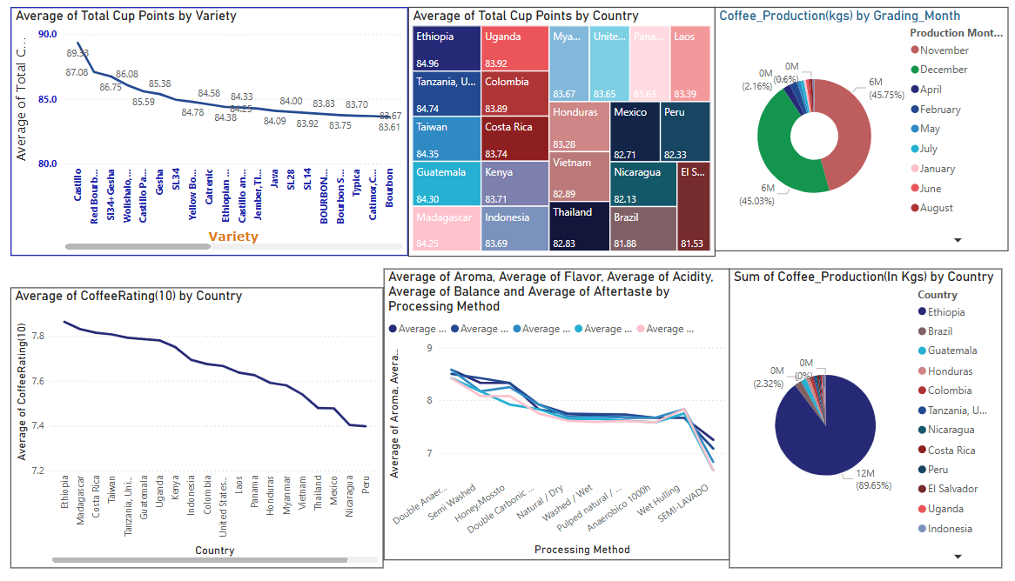

Slide 27
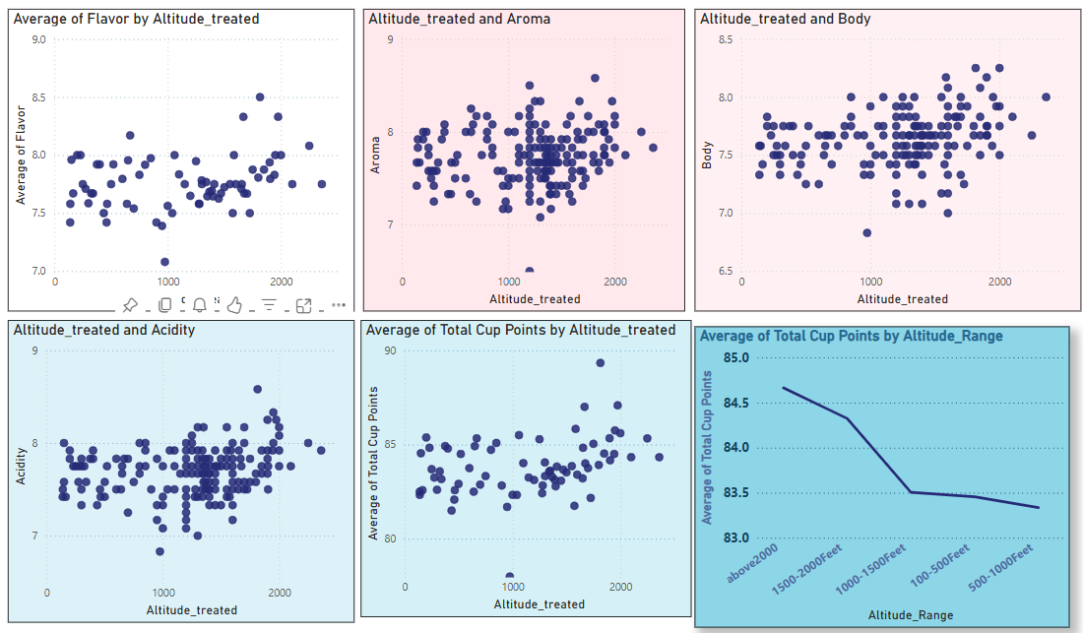

Slide 28
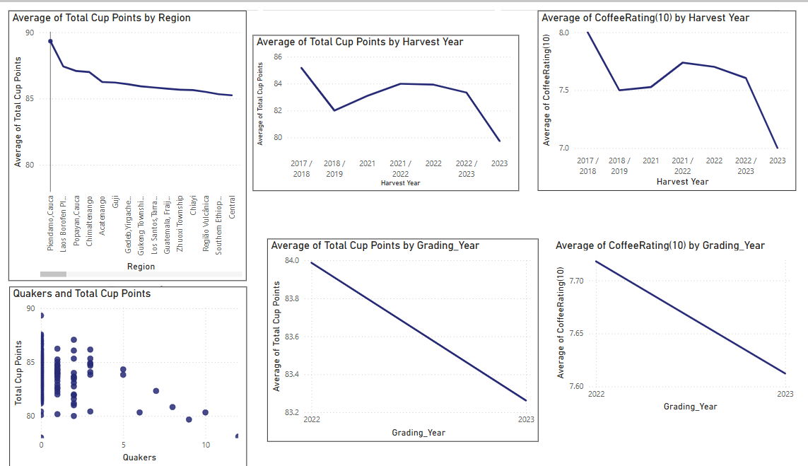

Slide 29
02
Analysis Report
Diggind deep into the Analysis

Slide 30
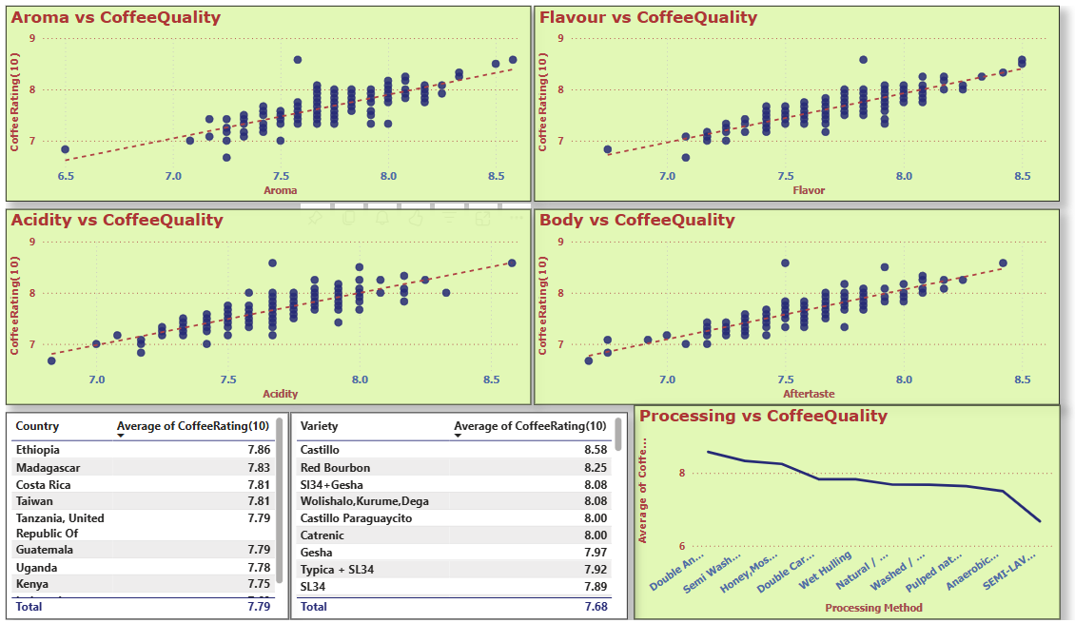

Slide 31
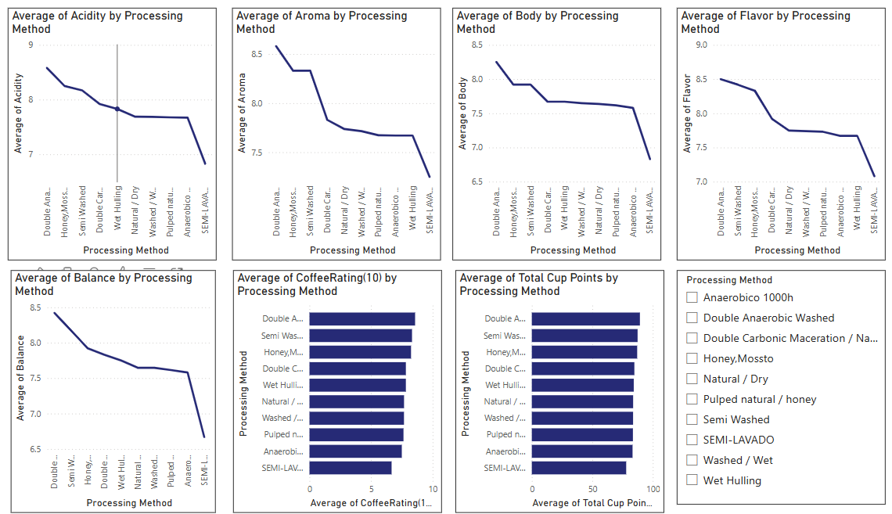

Slide 32
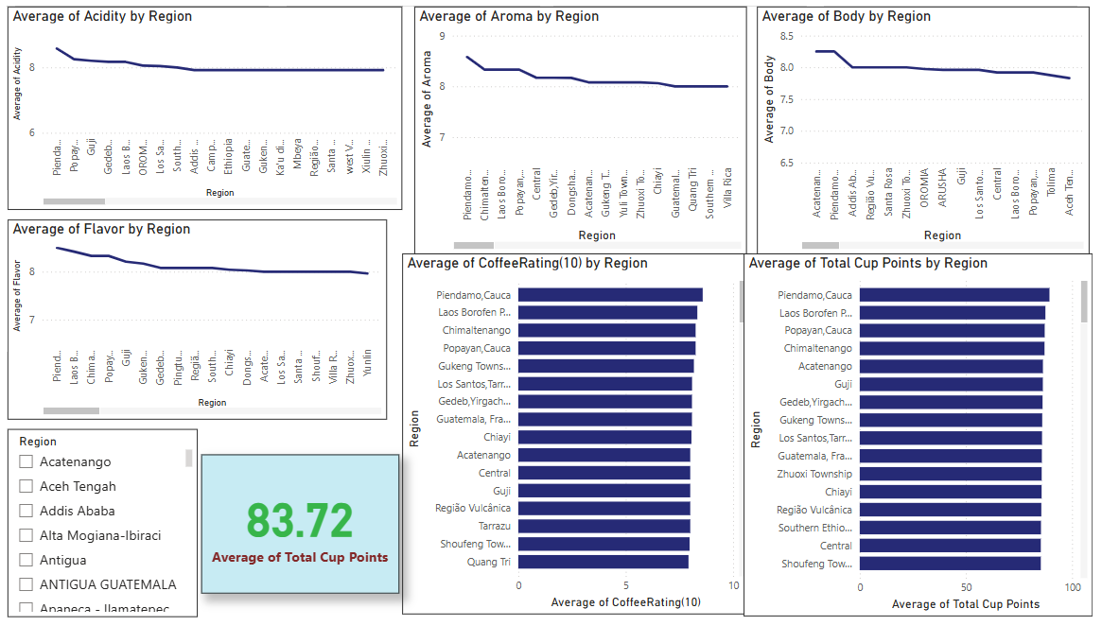

Slide 33
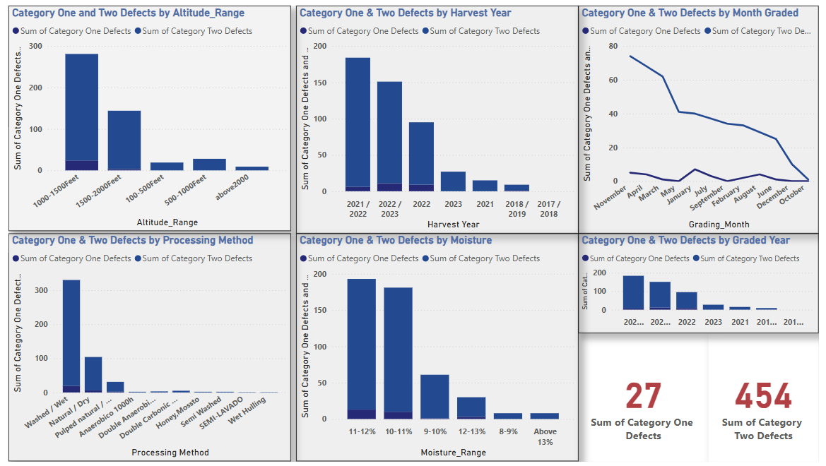

Slide 34
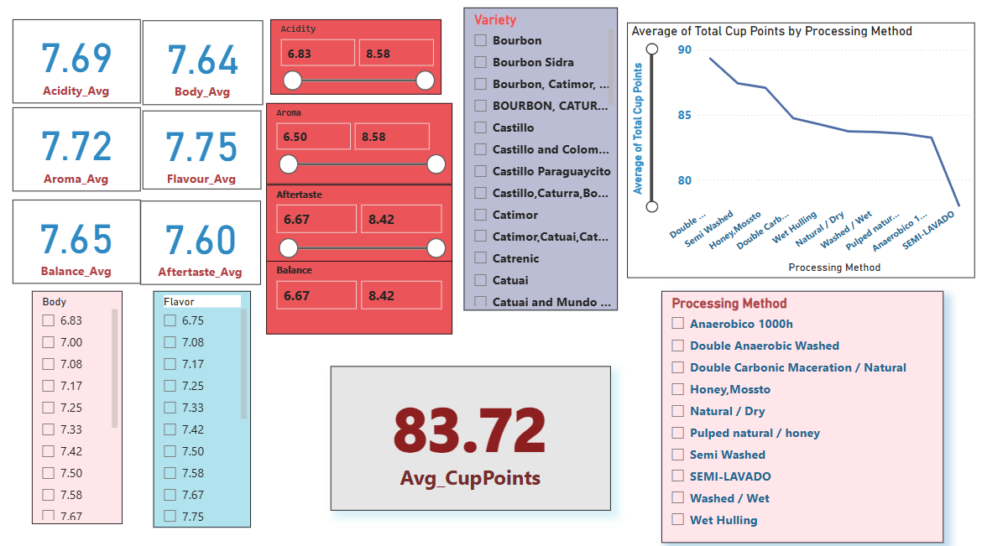

Slide 35
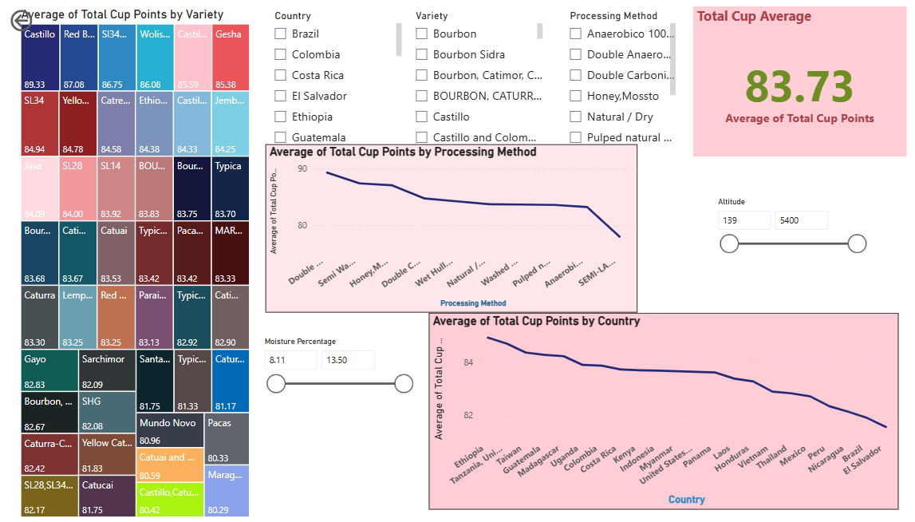

Slide 36
03
Insights
Outcome of Project

Slide 37
Insights:
What are the key determinants of coffee quality as evaluated through sensory attributes such as aroma, flavor, acidity, etc.?
- Aroma, flavor, Acidity, Body are the key attributes that impacts Coffee Quality much .
Castillo, Redbourn varieties are the top two Coffee Qualities.
Is there a correlation between processing methods, origin regions, and coffee quality scores?
The processing method impacts the coffee Bean attributes such as Acidity, Aroma, Body, Balance.
Regions in high Altitude produces Good Quality of Coffee Beans.

Slide 38
Insights:
Can we identify any trends or patterns in defect occurrences and their impact on overall coffee quality?
Category 2 defects are more compared to category 1 defects.
Washed/Wet processed beans has more defects.
November, April & March Graded Beans has more defects.
Beans with Moisture Range more than 10% has more defects.
Harvest year 2021/2022 & 2022/2023 has more defected beans.
Note : Here, the Coffee Bean production in the respective years and Processed method is high, so it may also be the reason for more defects.

Slide 39
Insights:
How do different variables interact to influence the Total Cup Points, which represent an overall measure of coffee quality?
The Overall Cup points of a Coffee is influenced by attributes Acidity, flavor, Aroma, Body, Balance, After taste. The increase in this attributes enhances the Coffee Quality Points.
Beans Processed with Double Anaerobic washed, Semi washed & Honey/Mossto methods has high Cup Points.
Castillo, Red Bourbon & Sl34+Gesha are top 3 Quality Beans when compared to Cup Points.
Ethiopia, Tanzania, Taiwan, Gautemela, Madagasarcar are the top 5 Countries.

Slide 40
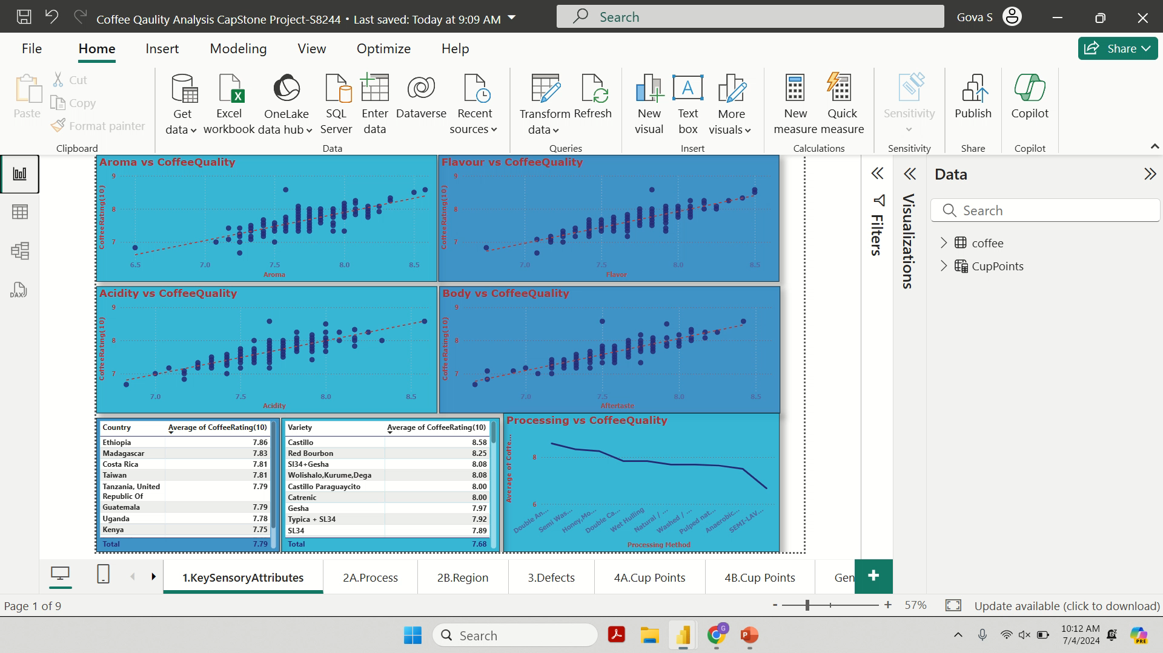
Project Video

Slide 41

Thank You
By Govardhan

